Slide 1
9/4/2024
Exercise 3: Homology Modeling
Structure prediction principles

Slide 2
Structure Prediction
This lecture is intended to help you achieve the following learning objective: Predict protein structure based on the sequence of amino acids. Express confidence in the quality of a structure prediction.
It will introduce
motivations of structure prediction
how structure space < sequence space
making predictions that maximize template information
the new deep learning methods, AlphaFold and its faster cousin, ColabFold
At the end of this lecture, we will have a discussion about:
What factors increase/decrease
your confidence in a predicted structure?
the influences of the prediction algorithm?
Can current structure prediction methods be used to predict the effect of a mutations or buffer conditions?

Slide 3
Exercise 3: Homology Modeling
https://colab.research.google.com/github/daveminh/Chem456-2024F/blob/main/exercises/03-Homology_Modeling.ipynb
Goal: start running Part II

Slide 4
Structure Prediction Principles

Slide 5
Why perform structure prediction?
Predict
functional differences between homologs (e.g. isoforms or different species)
effects of mutations
binding sites and drug interactions
Design the above
It’s easier than structure determination
Even with rapid expansion of the PDB, many-fold more sequences have been obtained
Fortunately…

Slide 6
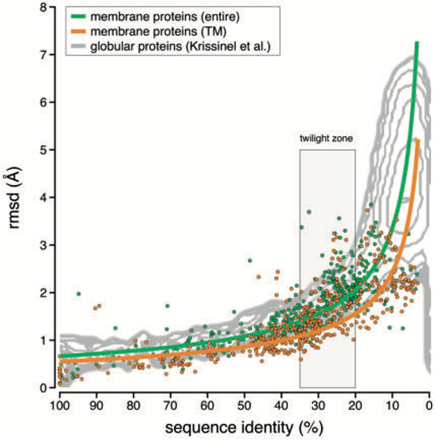
Structure < sequence space
The number of unique folds is far less than the number of sequences
Similar sequences have similar structure - in general, sequence identify only needs to be 30-40%!
Therefore we can model a sequence of unknown structure based on a homolog with known structure
But how?
Chothia C & Lesk AM (1986) _EMBO J_ 5(4), 823–826

Slide 7
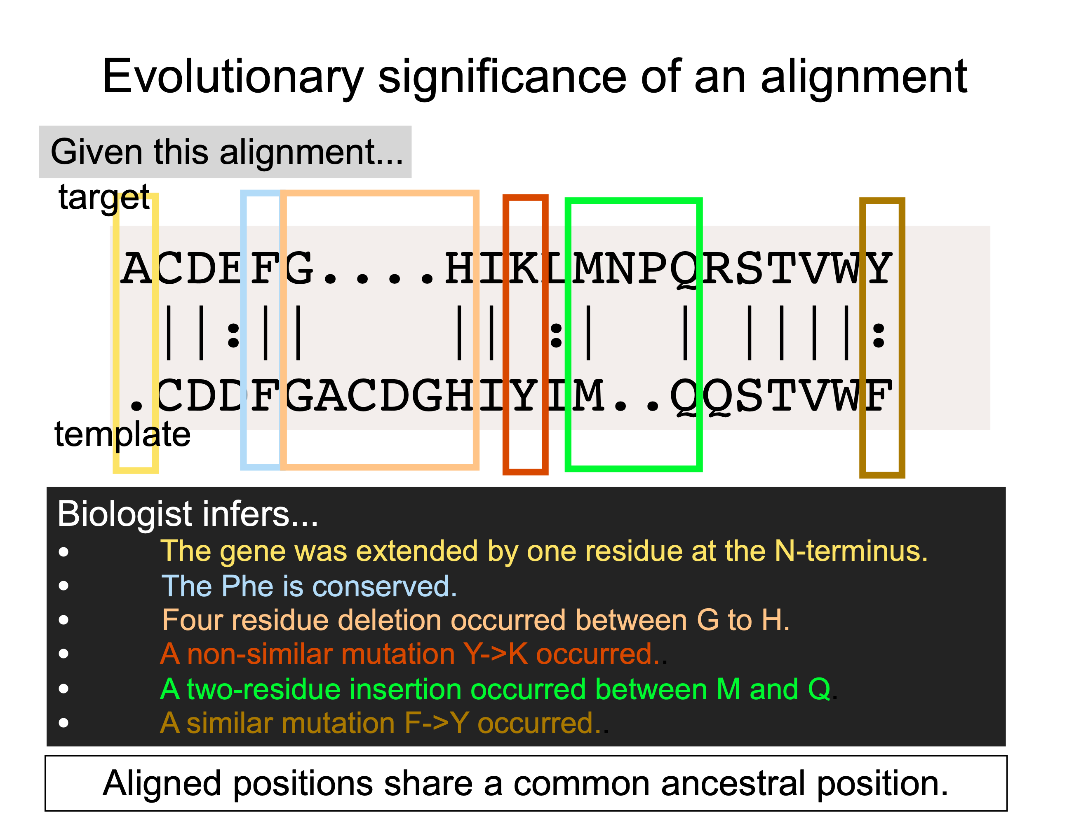
Bystroff, 2020

Slide 8
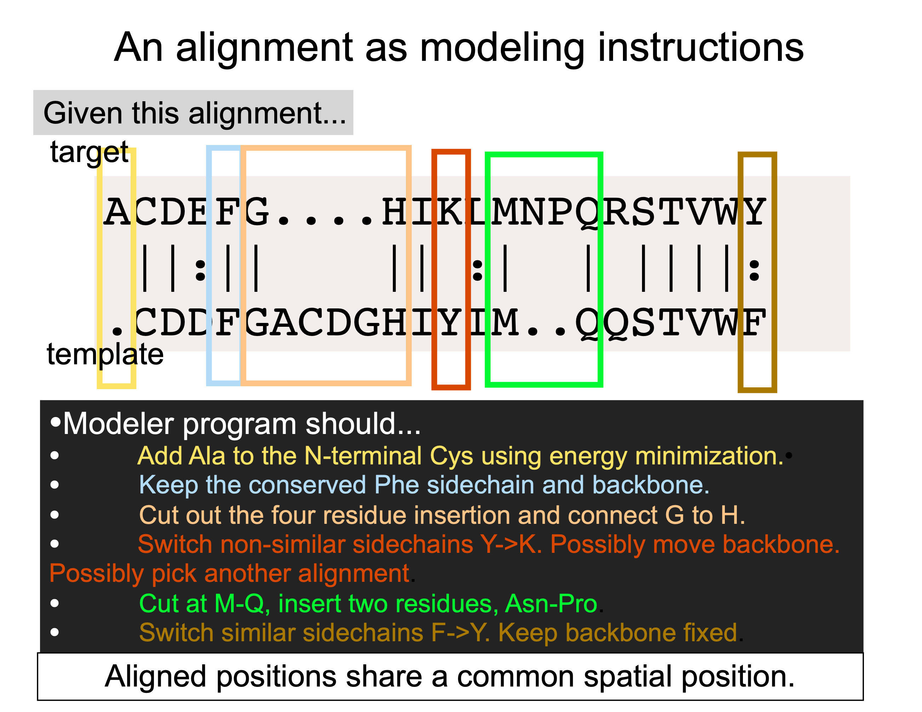
Bystroff, 2020

Slide 9
Choosing Structure Prediction Software
There are many software tools for protein structure prediction (see https://en.wikipedia.org/wiki/List_of_protein_structure_prediction_software)
How should you decide which to use?
Ease of use
Web server - easier for sporadic use
Downloadable and scriptable - easier for large-scale applications
Speed
Accuracy
Whether it uses many templates
Suppose that you have a crystal structure of a protein-ligand complex that is missing some loops. Do you want to use a structure prediction tool that has one or many templates?

Slide 10
CASP
“Critical Assessment of protein Structure Prediction” (CASP) experiments are blinded tests of the ability to predict structure from sequence. (see http://www.predictioncenter.org/index.cgi)
“I-TASSER (as 'Zhang-Server') was ranked as the No 1 server for protein structure prediction in recent community-wide CASP7, CASP8, CASP9, CASP10, CASP11, CASP12, and CASP13 experiments.”
“AlphaFold is an AI system developed by DeepMind that predicts a protein’s 3D structure from its amino acid sequence. It regularly achieves accuracy competitive with experiment.” “In CASP14, AlphaFold was the top-ranked protein structure prediction method by a large margin.”

Slide 11
Discuss
What factors increase/decrease
your confidence in a predicted structure?
the influences of choice of prediction algorithm?
Can homology modeling/threading be used to
predict the effect of a mutation
of a contact with a ligand in a binding site?
on a large-scale conformational change?
predict the effect of buffer conditions?

Slide 12
AlphaFold

Slide 13
AlphaFold 2 performance
https://www.nature.com/articles/s41586-021-03819-2

Slide 14
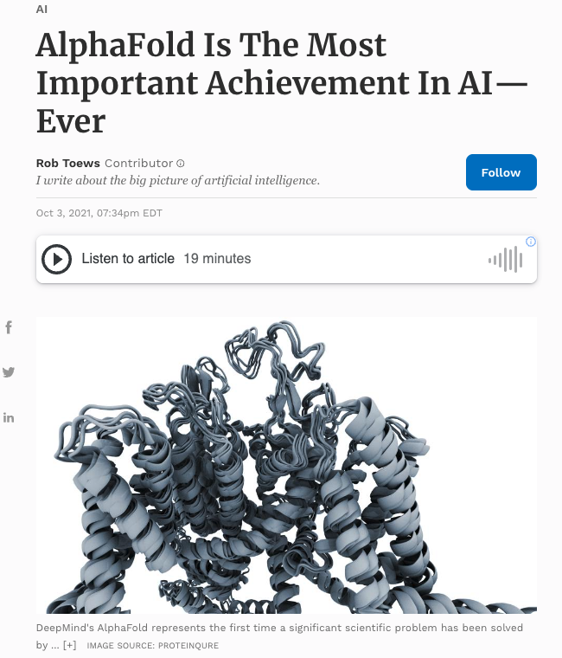
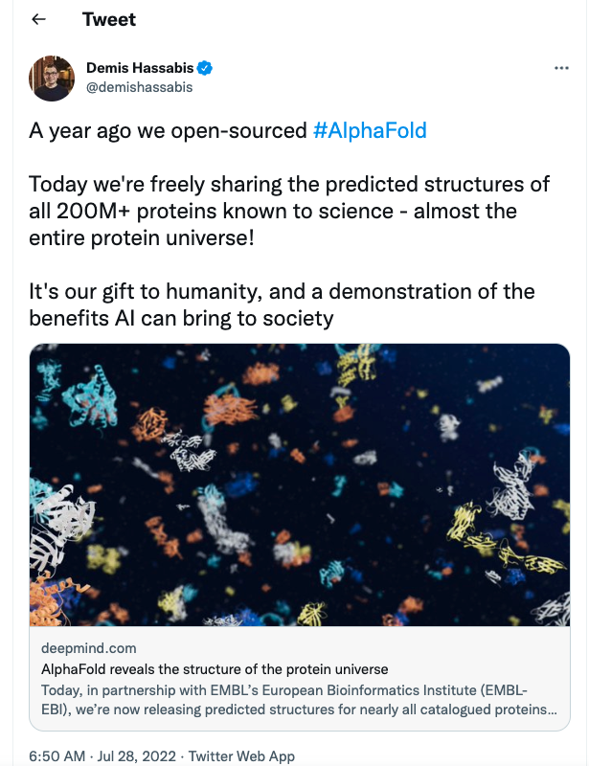
https://www.forbes.com/sites/robtoews/2021/10/03/alphafold-is-the-most-important-achievement-in-ai-ever/
https://twitter.com/demishassabis/status/1552622520406347777

Slide 15
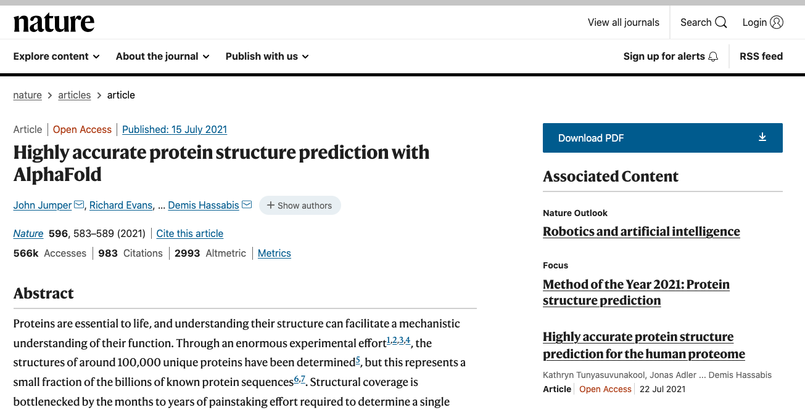
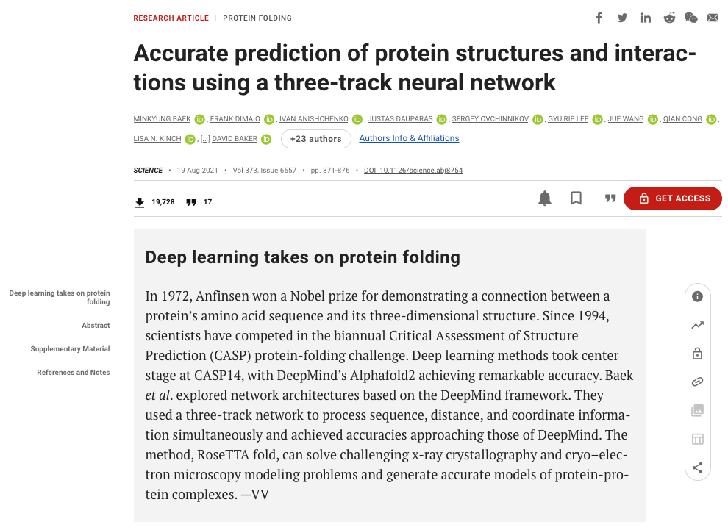
AlphaFold and RoseTTA fold

Slide 16
How does it work? An overview

Slide 17
Inputs
At the most basic level, a machine learning model takes inputs and produces outputs
For AlphaFold2, the inputs are
a multiple sequence alignment, a set of similar sequences from different organisms
MSA helps identify
which parts are most likely to mutate
correlations between mutations, or coevolution; amino acids that coevolve are likely to be close in physical space
pair representations of templates
pair representation includes distance between beta carbons, displacement of alpha carbons
https://www.blopig.com/blog/2021/07/alphafold-2-is-here-whats-behind-the-structure-prediction-miracle/

Slide 18
Transformer Overview
Series of functions that
take input
generate outputs
exchange information between MSA and pair representations
What is new? “Before AlphaFold 2, most deep learning models would take a multiple sequence alignment and output some inference about geometric proximity.”
https://www.blopig.com/blog/2021/07/alphafold-2-is-here-whats-behind-the-structure-prediction-miracle/

Slide 19
The New Transformer Concept
Conceptualization of the Evoformer information. In the left diagram, the MSA transformer identifies a correlation between two columns of the MSA, each corresponding to a residue. This information is passed to the pair representation, where subsequently the pair representation identifies another possible interaction. In the right diagram, the information is passed back to the MSA. The MSA transformer receives an input from the pair representation, and observes that another pair of columns exhibits a significant correlation.
https://www.blopig.com/blog/2021/07/alphafold-2-is-here-whats-behind-the-structure-prediction-miracle/

Slide 20
Structure
Takes transformed MSA and pair representations
Generates Cartesian coordinates
https://www.blopig.com/blog/2021/07/alphafold-2-is-here-whats-behind-the-structure-prediction-miracle/

Slide 21
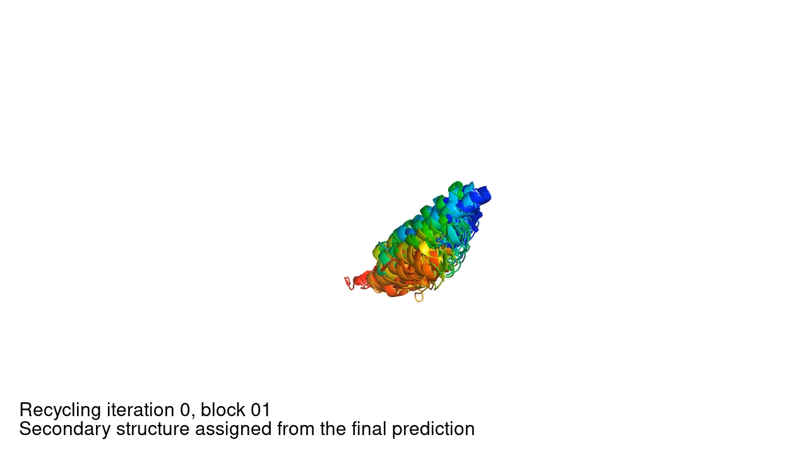
Structure module for each Evoformer block
https://www.nature.com/articles/s41586-021-03819-2#Sec20

Slide 22
Why does it work?
“it is a very sophisticated fold recognition algorithm that exploits the completeness of the library of single domain PDB structures” - Jeffrey Skolnick et al
“The incredible performance of this network seems down to DeepMind’s superb engineering” - Carlos Rubiera, Oxford

Slide 23
Limitations
The same as other prediction methods
Good input information (sequences and structures) is necessary
“AlphaFold predictions of fold-switched conformations are driven by structure memorization” https://www.nature.com/articles/s41467-024-51801-z
“AF2’s confidence metrics selected against models consistent with experimentally determined fold-switching structures and failed to discriminate between low and high energy conformations.”
“AF captured only one out of seven experimentally confirmed fold switchers outside of its training sets”
Does not
predict changes with conditions (buffer, ions, ligands) or dynamics
include molecules that are not amino acids

Slide 24
Exercise 3: Homology Modeling
https://colab.research.google.com/github/daveminh/Chem456-2024F/blob/main/exercises/03-Homology_Modeling.ipynb

Slide 25
References
Lecture 19 of BIOL 4550 by Chris Bystroff of Rensselaer Polytechnic Institute
Lab 04 of IIBM3202 Molecular Modeling and Simulation from the Institute for Biological and Engineering at Pontificia Universidad Catolica de Chile
Chothia C & Lesk AM (1986) _EMBO J_ 5(4), 823–826
AlphaFold paper: https://www.nature.com/articles/s41586-021-03819-2
Oxford Protein Informatics Group Blog Post: https://www.blopig.com/blog/2021/07/alphafold-2-is-here-whats-behind-the-structure-prediction-miracle/
Skolnick paper: https://www.ncbi.nlm.nih.gov/pmc/articles/PMC8592092/pdf/nihms-1751143.pdf
RoseTTA fold paper: https://doi.org/10.1126/science.abj8754

